Slide 1

DANGEROUS GOODS
10 October 2024
Dangerous Goods Inspector
Mr. David Khumalo

Slide 2

Dangerous Goods Part 92
Dangerous Goods Overview
Applicability and scope
Why the Change?
Part 92 Reasons for revision
What are the Changes?
Part 92 amendments overview
Training & Instructors
Part 92
Collaborative work
Collaborative work domestic, Regional and International

Slide 3
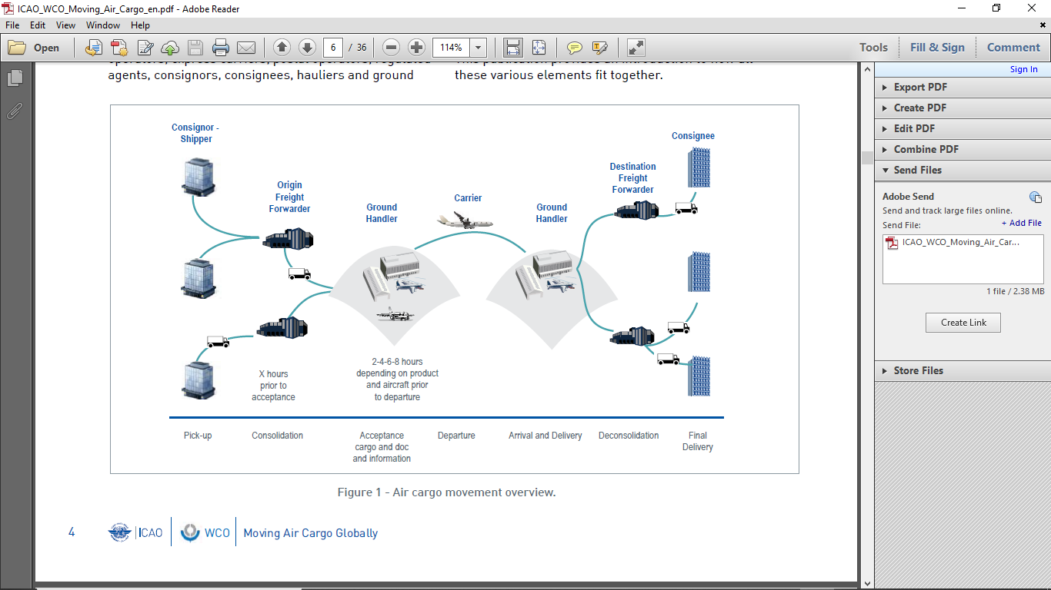
Applicability

Slide 4
Applicability
Operators/Airlines
Commercial aircraft operators: Fixed wing, helicopters, Drone operations, balloon operations .
Training Organisations
Aviation training organisations offering dangerous goods training
Airports
International and domestic serving airports
Cargo, Mail, baggage and passenger movements
Packers
Packers of Dangerous goods for Air transport.
Cargo/Shippers/Freight Forwarders
Cargo entities and facilities both at Airport and off the airport.
Package Testing Organisations
Testing organisations for air transport packages.
Post Office
Post office main mail and cargo centres .
Couriers
All courier with parcels or cargo for
air transport
Notes:
This template was inserted from Power-user, the productivity add-in for PowerPoint, Excel and Word.
Get thousands of templates, icons, maps, diagrams and charts with Power-user. Visit https://www.powerusersoftwares.com/!

Slide 5

Why the change?
ICAO requirements inclusion
Update the regulations with latest ICAO amendments as per SACAA internal gap analysis
Addressing Risk
To curb the rate of incidents that has been growing due to changes in the industry e.g., ecommerce and Lithium batteries
Improved structure of Regulations
Better structure and readability of the regulation. The Regulation has been subdivided into 4 subparts
Relevant Regulations
Developing regulations that are appropriate and relevant to the South African Industry –clarity on approval processes

Slide 6
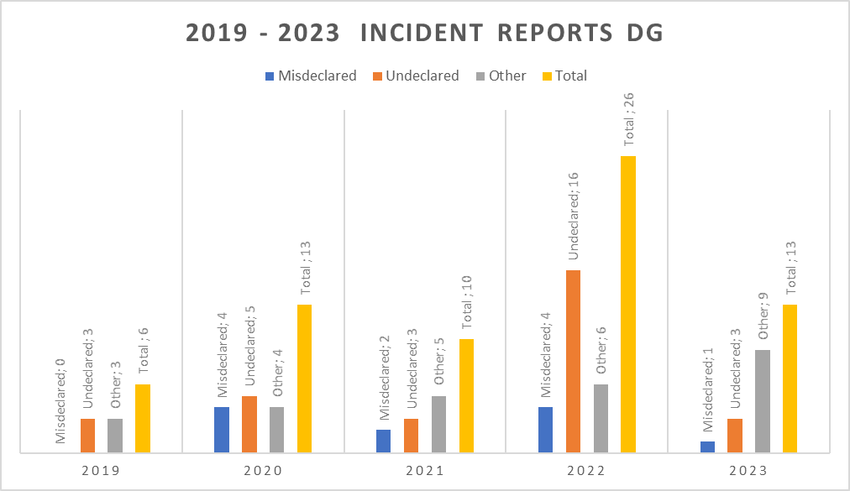
DG Incidents

Slide 7

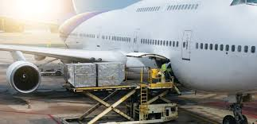
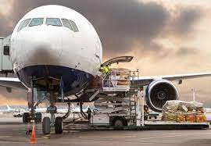
Cargo and other entities compliance summary
Dangerous Goods in
Air Cargo
01
02
Entities requiring approval
All Entities with no approval
Any cargo handling entities in the supply chain including Aerodromes
Any entities doing final acceptance of cargo/ dangerous goods before it is loaded onto an aircraft
Submit an MOP for approval
Application for Certification
MOP must contain CBTA program
Submit MOP with CBTA program
Ensure declaration for non-dg cargo is given to the handling agent or operator
Five Phase Process will apply
Will be added on the CAA list
Does not handle dangerous goods
Ensure declaration for non-DG cargo is given to the operator
Hand dangerous goods cargo to approved agent for final acceptance
Keeps all DG Documentation
Reject or rescreening in the absence of declaration
Reject or rescreening in the absence of declaration
Report incidents
Report incidents

Slide 8
5 Phase Process
1
2
3
4
5
Pre-Application Phase
Formal Application Phase
Document evaluation
Demonstration Phase
Certification Phase
Formal application
Application form
Proof of payment
Submission of relevant manuals- MOP/TPM/CBTA/FOM
Initial discussion based on intent..
SACAA- gives A-Z information pack on how to do a particular approval/certification
Explain Phase 2 -5
Formal evaluation of manuals by the CAA
CBTA program
MOP
TPM
OM
CBTA manual and assessments
Demonstration
Audit is conducted at place (s) of operation to verify the manuals contents
In case of air operator, a demo flight may be required.
Certification
Evaluation of the entire process
Issuance of the certificate

Slide 9
P92 Regulation structure
1
SUBPART 1
Subpart 1 deals with the operational requirements of the old Part 92 excluding the Training requirements.
SUBPART 2
2
Subpart 2 deals with training requirements in line with the Competency Based training and assessments for Dangerous Goods (CBTA)
3
SUBPART 3
Subpart 3 deals with approval of an aviation Training organisation to train dangerous goods in line with Part 141 and Part 109 .
SUBPART 4
4
Subpart 4 deals with dangerous goods instructor requirements and accreditation.

Slide 10
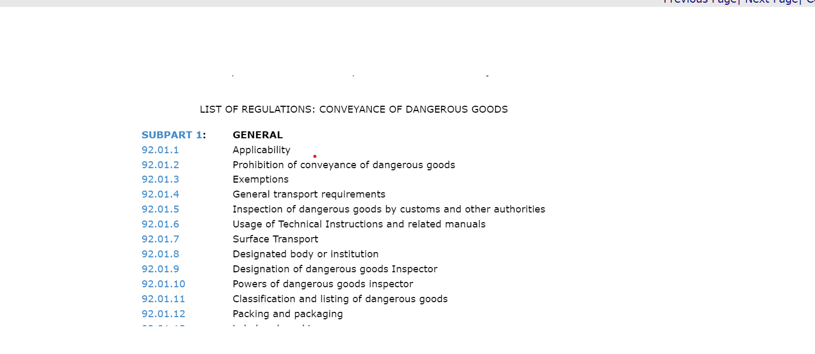
P92 Regulation on Lexus Nexus

Slide 11
Subpart 1- Operational requirements
1
Applicability has been expanded to include entities which are not operators but are involved in the Dangerous Goods supply chain as per the standard 11 (Annex 18)
92.01.1
2
Addressing the usage of the ICAO Technical Instructions for the safe transport of dangerous goods and the acceptability of the IATA Dangerous Goods Regulations manual
92.01. 6
3
Inspection of dangerous goods by customs
92.01.5
4
Operators' compliance with dangerous goods.
92.01.17
5
Requirements for operators with no approval to carry dangerous goods as cargo
92.01.18

Slide 12
Subpart 1- Operational requirements
6
Requirements for operators with specific approval to carry dangerous goods as cargo
92.01.19
7
Additional requirements for Helicopter operators
92.01.21
8
Safety management systems related regulations addressing Risk assessment, cargo compartments in line with Annex 6 –chapter 15 cargo safety requirements
92.01.22-24
9
Transportation of company material (COMAT).
92.01.27
10
Dangerous Goods designated areas within cargo warehouses
92.01.26

Slide 13
Subpart 1- Operational requirements
11
Cargo entities requirements (shippers/couriers/freight forwarders/packers) including approval to handle dangerous goods
92.01.47
12
Requirements for online retailers
92.01.48
13
Detaining of dangerous goods packages pending an investigation
92.01.54
14
Dangerous Goods Security – High consequence dangerous goods
92.01.55

Slide 14
Subpart 1- Operational requirements
11
Cargo entities requirements (shippers/couriers/freight forwarders/packers) including approval to handle dangerous goods
92.01.47
12
Requirements for online retailers
92.01.48
13
Detaining of dangerous goods packages pending an investigation
92.01.54
14
Dangerous Goods Security – High consequence dangerous goods
92.01.55

Slide 15
Subpart 2- Training
VALIDATION OF FOREIGN TRAINING PROGRAMMES
VALIDATION OF FOREIGN CERTIFICATES
Requirements for foreign training programmes validation
TRAINING PROGRAMMES
Validation of foreign certificates
GENERAL TRAINING REQUIRENTS
Establishments of training programmes in line with Competency Based Training and applicability of training
General training requirements replacing the old Part 92.00.8. addresses validity of training
Validations:
92.02.4
92.02.5
Training programs:
92.02.2
General requirements
92.02.1

Slide 16
Subpart 3- Training Organisations
1
General
Links with Part 141 (Safety Training)
Requirements for approval
2
Application and the approval process
3
Training Procedures Manual
Training procedures manual requirements .
Record Keeping
4
Record keeping requirements .
5
Personnel Requirements
Personnel requirement and record keeping requirements .
Regulations: Part 92.03.1 to Part 92.03.6

Slide 17
Subpart 4- Instructor accreditation
1
Requirements for accreditation
2
Competency to conduct training
Requirements for how to become a dangerous goods instructor
Highlight qualification and competency requirements required
3
Validity of the certificate
4
Validation of Foreign instructor certificates
Validity of the certificates
Validation of certificates of foreign instructors wishing to conduct dangerous goods training within South Africa.
Regulations: Part 92.04.1 to Part 92.04.5

Slide 18
Dangerous Goods in
Air Cargo
Who must be certified?
An air service operator or a cargo handling agent seeking to handle dangerous goods in terms of this Part shall seek approval of the Director as prescribed in Document SA-CATS 92.
92.1.47 (5) (6)
A dangerous goods packing organisation within the Republic involved in packing services for dangerous goods conveyed by air.
92.01.47 (10)
An entity dealing with or handling cargo to be conveyed by air shall comply with requirements in Regulation:
92.01.47 (7)
Also see 92.01.47 (1)(2)(3)(4) (8) (9) (11)
2
1
3
Regulations: Part 92
Regulation 92.01. 47
Notes:
This template was inserted from Power-user, the productivity add-in for PowerPoint, Excel and Word.
Install Power-user to access thousands of templates, icons, maps, diagrams and charts with Power-user.
Visit https://www.powerusersoftwares.com/
©Power-user SAS, terms of license: https://www.powerusersoftwares.com/terms

Slide 19
Regulatory considerations
Old | New
Job title-based Table 1.5.A and 1.5.B | Competency Based with well-defined functions New guidance required
Legal Basis- Part 92, CATS, Technical Instructions –IATA DGR | Amendment of regulations to reflect the same changes Consider DOC 10147 Also check IATA guidance
Training Programme- Operations Manual, Training Procedures Manual, Procedures Manual | Develop guidance to assist industry to comply CBTA training programmes must be developed Training Manuals must be aligned to CBTA
Knowledge based assessments | Addition of practical /on the job assessment On the Job assessment – programme and assessors
CAA approved Instructors /Category 6 | CAA approved Instructors/ advanced proficiency – requires hands on –on the job experience for functions being trained
Notes:
Discuss what it was versus the new system

Slide 20

Role Players
Employer
Trainer/instructor
CBTA programme requirements
Application for approval
Submission for approval
Qualification requirements
Accreditation process
Visit to operations
Renewal process
Evaluation feedback
Regulator
Assessors
CBTA applicability scope
CBTA requirements
Provide TGMs/Checklist/application forms
Approval of CBTA programmes
Oversight
Record keeping
Qualifications
Competencies
Accreditation

Slide 21
Employer
Employers are required to ensure personnel are competent to perform any function for which they are responsible prior to performing them
Responsibility
1
The Employers conduct training needs analysis (TNA) to determine the results that the training needs to achieve and what resources exist to achieve them- determine the purpose and objectives
Training needs analysis
2
Employers are responsible for all 4 phases of the Competency based training and assessment program.
Training Program
3
Employers may delegate some aspects to third party providers; however, employers will remain responsible for the training program.
Third Parties
4

Slide 22
Trainers/Instructors
Training
Trainers must be trained on an advanced proficiency level of Dangerous Goods.
01
Accreditation
Trainer must be accredited by after undergoing internal processes. (observe, interact and lead)
02
Experience
Minimum 3 years working knowledge and experience in dangerous goods and safety operations or cargo operations, including function they are training on..
03
Instructional training program
Instructor must be trained on an instructional program. In South Africa:
Train the trainer
Assessor training
Hands on job experience
Instructors must undergo practical activity at least every 2 years in the operation they are training on.
04
05

Slide 23

Third Parties
1
Aviation Training Organizations
Offering Training
2
ATOs or any independent organisation
Offering assessment services
May conduct Training and assessments in line with the employer’s approved training program
May be contracted to carry out employer responsibilities but a clear contractual agreement must be in place and the SACAA must be informed
Notes:
This template was inserted from Power-user, the productivity add-in for PowerPoint, Excel and Word.
Install Power-user to access thousands of templates, icons, maps, diagrams and charts with Power-user.
Visit https://www.powerusersoftwares.com/
©Power-user SAS, terms of license: https://www.powerusersoftwares.com/terms

Slide 24

Assessors
1
Employer representative. E.g., Supervisor
2
Training Organization. E.g., Instructors, Designated examiners
3
Dangerous Goods Responsible person.
CERTIFICATE
Assessor Qualification.
Dangerous goods Group A advanced proficiency
Knowledge of the operation

Slide 25
Groupings
DG acceptance personnel/ DG advanced proficiency Level
Group A
DG acceptance personnel. DG advanced proficiency level for Instructors/moderators/assessors, etc
Group B
Non-DG cargo acceptance personnel
Non-DG cargo
Group C
Pilots/Load Controllers
Pilots, Load controllers, Flight Dispatch, Flight Operations officer
Group D
Cabin Crew
Cabin Crew
Group E
Passenger handling, baggage handling, security
Check-in, Baggage handlers, Warehouse personnel, security
Shippers/Packers of dangerous goods
Group F
Shippers/packers/freight forwarders/courier personnel
Group G
Shipping of infectious substances
Group H
Lithium batteries

Slide 26
Curriculum guideline
Group B
Group D
Group E
Group F
Group G
Group H

Slide 27

The Regulator
Authority’s internal considerations- Technical Guidance material and procedures
1
The Authority
2
The industry
Regulations
Technical guidance for Inspectors
Policies and Procedures
Checklists
Technical guidance for the Industry
Checklists for the industry
Consultations with industry
Notes:
This template was inserted from Power-user, the productivity add-in for PowerPoint, Excel and Word.
Install Power-user to access thousands of templates, icons, maps, diagrams and charts with Power-user.
Visit https://www.powerusersoftwares.com/
©Power-user SAS, terms of license: https://www.powerusersoftwares.com/terms

Slide 28
Operator compliance summary
Dangerous Goods in
Air Cargo
03
04
Operators- NO DG approved
DG approved Operators
Non- DG approved
Any entities doing final acceptance of cargo/ dangerous goods before it is loaded onto an aircraft
Application for DG approval
Application for CBTA approval
Submit OM DG Section with CBTA program
Submit OM DG Section containing CBTA program
CBTA Manual and assessments
CBTA Manual and assessments
Five Phase Process will apply
Does not handle dangerous goods
Ensure declaration for non-DG cargo is given to the operator
Receives cargo with declaration that its not DG.
Keeps all DG Documentation for DG shipments
Rejects or request rescreening in the absence of declaration
Reject or request rescreening in the absence of declaration
Report incidents
Report incidents
Regulation 92.01. 47

Slide 29
Collaborative work
01
DOMESTIC
02
REGIONAL
03
INTERNATIONAL
DANGEROUS GOODS SUPPLY CHAIN TASK GROUP
DANGEROUS GOODS AFRICA FORUM
ICAO PANEL
An initiative by the Department of transport to have all modes of transport regulators involved with the transport of dangerous goods to work together: Rail, Road, Sea and Air.
Aim is to develop a South African standard, share expertise and discuss matters of common interest
An initiative by the SACAA DG Section to coordinate efforts with other CAAs/Authorities in the African Continent. This is done to ensure alignment with the Single African Air Transport Market (SAATM)
Member of workgroup dealing with the Technical Instructions supplement
2. Member of the dangerous goods RPAS workgroup
LOCAL
Dangerous goods working group
Discussing papers before going to panel meetings and sharing feedback upon return

Slide 30




QUESTIONS?
QUESTIONS? ? ?

